Slide 1
Want to be a millionaire?
Group 5
Yidi Wu
Iulian Toma
Ji Nan

Slide 2
Task
Decision
Idea
Objective

Slide 3
Core Issues
Interface
Class diagram
How to play the game

Slide 4
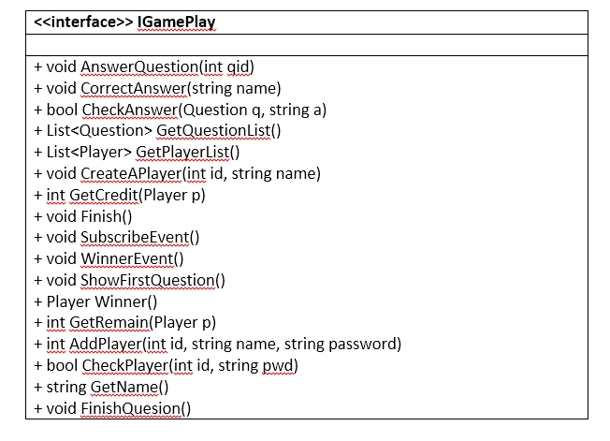
Interface for Game

Slide 5
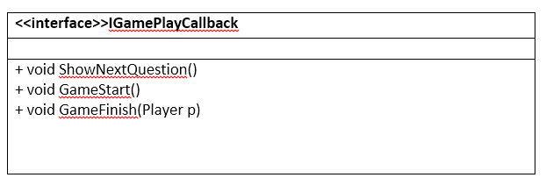
Interface for Callback

Slide 6
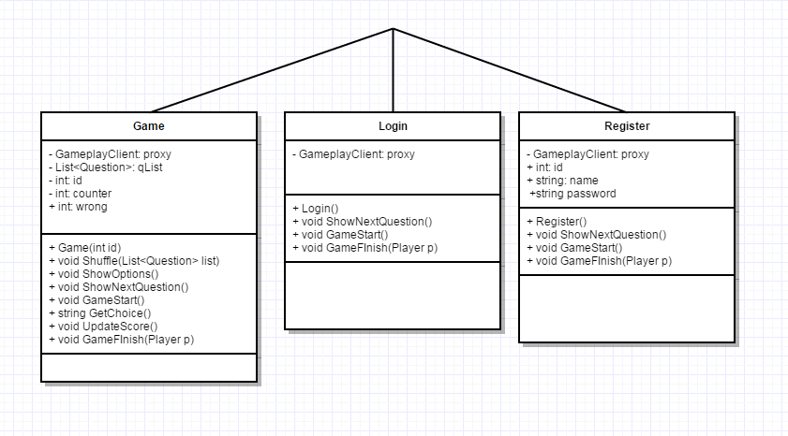
Class diagram: Client

Slide 7
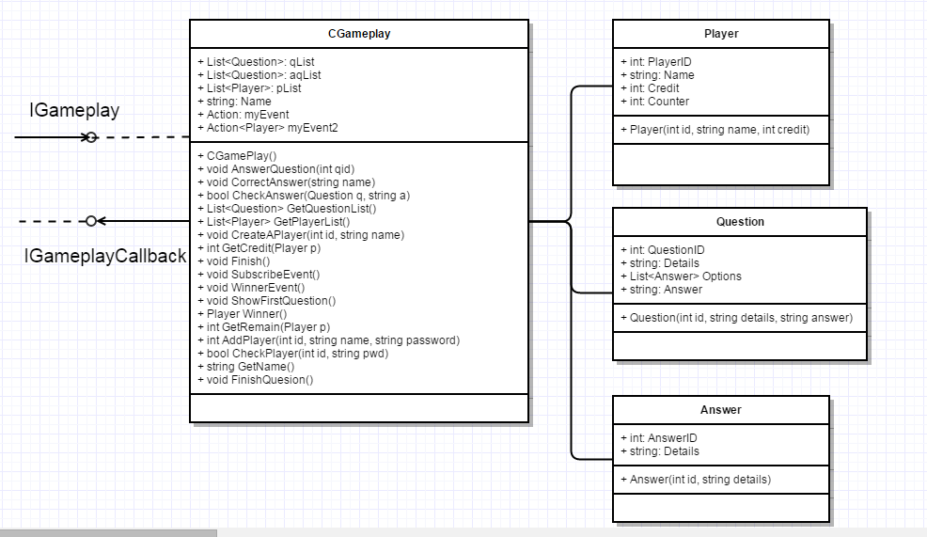
Class diagram: Server

Slide 8
The Game
Register
No
Registered?
Yes
Game
Login

Slide 9
The End &
Thank you!

Slide 10
Questions？

